Slide 1
Predicting the Success of Terrorist Attacks Using logistic Regression Analysis
Jaden Goodwin
STA3180

Slide 2
Introduction
Terrorism has continued to be a threat to global and national security
232,000 deaths worldwide over the span of 2000 – 2020
Highlight risk outcomes for future attacks based on the current number of successful ones
Research goal: Provide data algorithms to help:
Predict future threats
Investigate terrorism not as an academic topic but as an evolving global issue
GTD: highlights many mass casualties based on variables such as country, city, exact location, summary, and success

Slide 3
LITERATURE REVIEW
Found that there is a gap in the literature about predicting success with more recent global data (Pape, 2003)
Suicide attacks are identified as highly lethal due to attacker commitment and ability to bypass security (Pape, 2003)
Qu (2024) used confirmatory factor analysis to identify harm level indicators, which combined subjective harm (per area) with objective metrics to score on a global basis
Xu (2024) identified key regions where terrorism has occurred for visual purposes, finding that prominent regions included Middle and North Africa, South Asia, Central Asia, and Central America and the Caribbean (Xu, 2024, p. 1)

Slide 4
LITERATURE REVIEW
Logistic Regression to Predict Likelihood of Future Incidents
Tarakji (2021) performed logistic regression to classify events
Random forests for capturing non-linear relationships
Neural networks to enhance prediction accuracy
Logistic regression revealed statistically significant predictors:
Political instability, unemployment, and proximity to conflict zones
Each factor increased the likelihood of an attack by 10–15% (Tarakji, 2021, p. 31)
Found an increase in various regions like the Middle East and South Asia (Tarakji, 2021, p. 56-57).

Slide 5

Data
The data used comes from the Global Terrorism Database 2000–2020 records. To clean the data, doubtful cases, cases with missing predictor values, outliers, and undefined categories are excluded
Variables: The predictor variables used are “attacktype1”, “region”, “weaptype1”, “targtype1”, “nperps”, and “suicide”. They each had their own levels/responses. Since the response variable “success” is binary the two possible outcomes are 1=successful and 0=unsuccessful

Slide 6
Predicting the Success of Terrorist Attacks Using logistic Regression Analysis Part 2
Jaden Goodwin
STA3180

Slide 7
MEthodS

Slide 8
Methods: Analysis
Logistic Regression Model: the primary modeling method with 5% alpha level to fit binary nature of the response
AIC Stepwise Selection: AIC helps determine the best variable combination for fitness and complexity
K-fold Cross Validation: cross validation model with k=10 helps prevent overfitting
Confusion Matrix: the confusion matrix helps determine the sensitivity and specificity of the prediction model
ROC Curve and AUC: the ROC curve helps to visualize and analyze model performance across different classification thresholds and the AUC measures the overall performance of the binary classification model
Youden’s J-Statistic: this method attempts to balance the sensitivity and specificity of the model and is determining the optimal classification threshold

Slide 9
Results

Slide 10
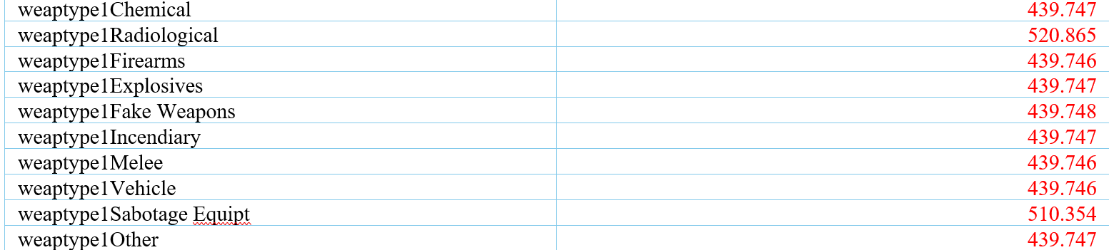
Logistic Regression
Binary response: success
Model reduction: stepwise selection
Chosen model: 5 predictors: suicide, attacktype1, region, weaptype1, and targtype1
Unstable estimates for predictor weaptype1: large standard errors and coefficients
Notes:
A full logistic regression model was constructed and includes predictors nperps, suicide, attacktype1, region, weaptype1, and targtype1.
Stepwise model selection was used. First attacktype1 was added to the null model, then weaptype1 was added, then targtype1 was added then region, and finally suicide. The AIC of the full model is 9736.034
- The logistic regression model with the lowest AIC according to stepwise model selection was with 5 predictors: attacktype1, weaptype1, targtype1, region, and suicide. Forward selection and backward elimination methods also had the same results.
-The AIC of the five-predictor model is 9734.113.
-A table of the 5-variable logistic regression model standard errors was created. The standard errors for the variable weaptype1 are incredibly large in magnitude. This is an indication of numerical instability or multicollinearity. Removal of the variable is best for the rest of the analysis. Thus, the chosen model is a four-predictor model with attacktype1, region, suicide, and targtype (Appendix B).

Slide 11
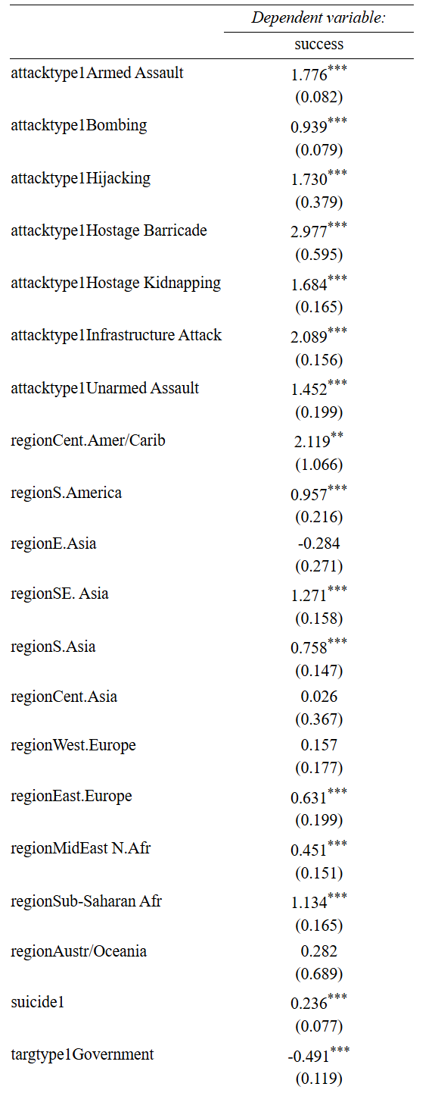

Logistic Regression
Final model with four predictors: attacktype1, region, suicide, and targtype1
Notes:
All the attacktype1 categories were highly significant with positive coefficients, meaning that certain attack types have varying increasing effects on the probability of attack success.
The region categories Central America/Caribbean, South America, Southeast Asia, Eastern Europe, Middle East/North Africa, and Sub-Saharan Africa were all statistically significant and positive, indicating that in these regions there is a higher probability of attack success.
The suicide predictor is also highly significant and positive, meaning that suicide attacks increase the probability of attack success.
The targtype1 statistically significant categories include Government, Police, Abortion Related, Airports, Diplomatic, Maritime, and Transportation are significant and vary on being positive or negative. Note that the targtype1 category Food and Water Supply has a very large coefficient and standard error and is not significant.

Slide 12
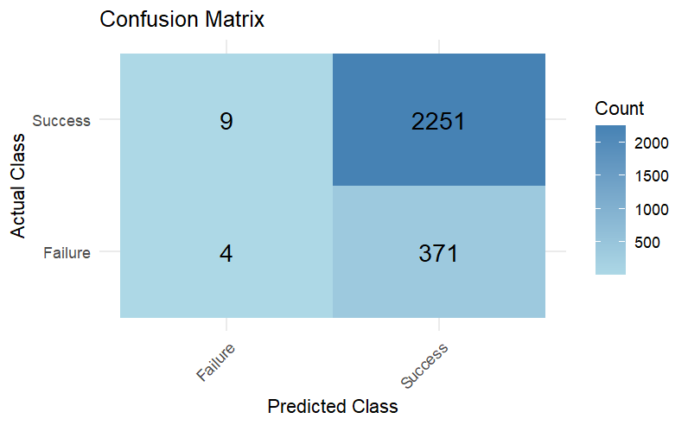
Test Data Confusion Matrix
80-20 training and test datasets
Threshold: 0.5
Accuracy 0.8558
95% CI: [0.8418,0.869]
Notes:
-To test the prediction abilities of the logistic regression model, the data was split into training and test datasets using the 80-20 method. Using a threshold of 0.5, with a probability less than 0.5 classified as a failure and greater than 0.5 classified as a success
-The overall accuracy of the model is 0.8558 with a 95% confidence interval of [0.8418,0.869] on the test dataset. There is an evident numerical imbalance in the success variable, with significantly more successes than failures indicated by shading in the confusion matrix.

Slide 13
Test Data Confusion Matrix
Performance by Class
Metric | Results
No Information Rate | 0.858
P-Value [Acc>NIR] | 0.6227
Sensitivity | 0.996
Specificity | 0.011
PPV | 0.859
NPV | 0.308
F1 | 0.922
Prevalence | 0.858
Detection Rate | 0.854
Detection Prevalence | 0.995
Balanced Accuracy | 0.503
Notes:
-This is the p-value from a compares the accuracy to the No Information Rate. A high p-value (typically > 0.05) indicates that there's not enough statistical evidence to say the model's accuracy is significantly better than simply guessing the majority class. In this case, with a p-value of 0.6227, your model's overall accuracy isn't statistically significantly better than the baseline
-The results show a very high sensitivity but an extremely low specificity. High sensitivity means that the model is good at classifying cases of success (top right square of the confsion matrix). Low specificity indicates that the model is not good at classifying failures (bottom left square of confusion matrix).
-The model seems to be heavily biased towards predicting the positive class, which explains the high detection prevalence and the low specificity and NPV.

Slide 14
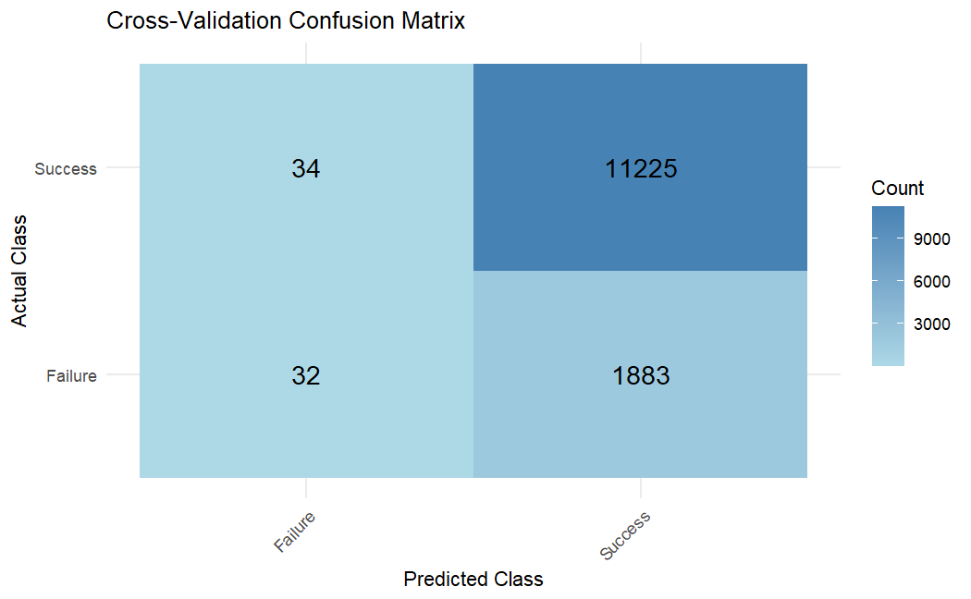
Cross-Validated Data
k=10 folds
Threshold: 0.5
Accuracy: 0.854
95% CI: [0.8483,0.0.8605]
Notes:
We used CV for more reliable, less biased, and more robust assessment of a model's performance and so it can be easier to generalize to new data.
The overall accuracy of the cross-validated model is 0.854 with a 95% confidence interval of [0.8483,0.0.8605], very similar to the previous model.

Slide 15
Cross-Validated Data
Cross-Validation Performance by Class
Metric | Result
No Information Rate | 0.8545
P-Value [Acc > NIR] | 0.5258
Sensitivity | 0.997
Specificity | 0.017
PPV | 0.856
NPV | 0.485
F1 | 0.921
Prevalence | 0.855
Detection Rate | 0.852
Detection Prevalence | 0.995
Balanced Accuracy | 0.507
Notes:
The sensitivity, specificity, PPV, and NPV are very similar to the previous estimates without cross-validation, which is what we anticipated.
-Very slight improvements in balanced accuracy and NPV and specificity though.
- The p-value did decrease using the cross-validated model, but it is still much larger than 0.05, indicating that there is not enough evidence to say that the model accuracy is significantly better than the accuracy from guessing the most frequent class.

Slide 16
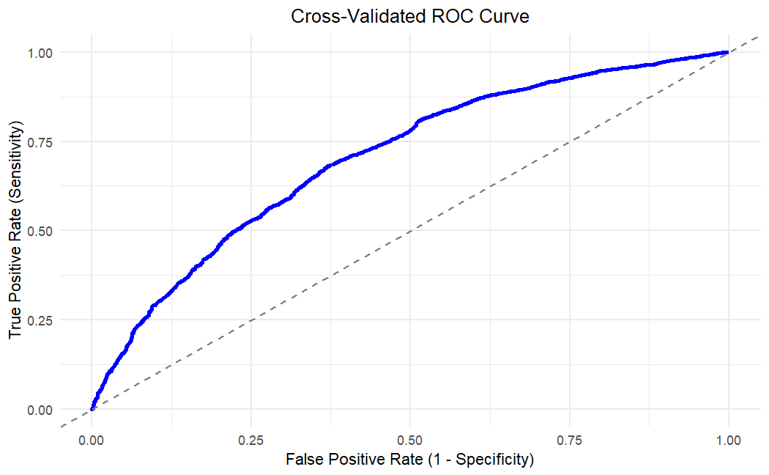
ROC Curve
AUC=0.70411
Notes:
-An ROC curve was constructed to visualize the cross-validated model tradeoff between sensitivity and false positive rate
The AUC ranges from 0 to 1 , An AUC greater than 0.7 is generally considered good. An AUC close to 1 indicates excellent performance.
-The AUC= 0.70411, which is considered good model performance in the trade-off between sensitivity and specificity.
-We used the AUC to calculate Youden’s J in R for the optimal threshold in the next slide to try and correct the class imbalance problems with the model.

Slide 17
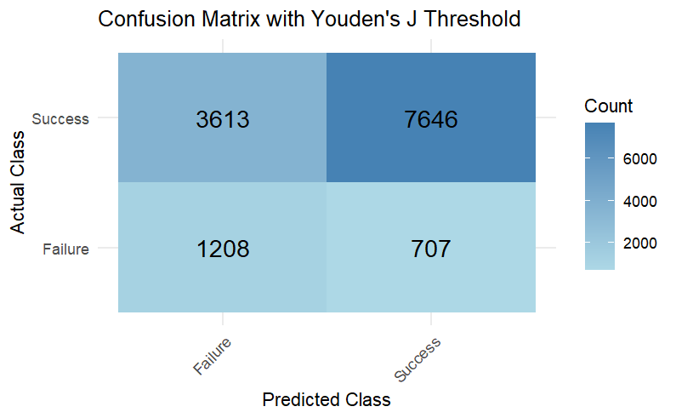
Optimal Threshold
J statistic threshold: 0.8534
Accuracy: 0.6721
95% CI: [0.664,0.6801]
Notes:
-Youden’s J statistic was calculated to be 0.8534 as the new threshold, maximizing the sum of sensitivity and specificity
-The overall model accuracy is 0.6721 with a 95% confidence interval of [0.664,0.6801]. This is a decrease in accuracy compared to the previous models. As you can see there are many more observations on the left side of the confusion matrix now shown by the shading of the matrix. The sensitivity and specificity are close to even as well, due to the nature of Youden’s J.

Slide 18
Optimal Threshold
Performance with Youden's J Threshold (By Class)
Metric | Result
No Information Rate | 0.855
P-Value [Acc > NIR] | 1
Sensitivity | 0.6791
Specificity | 0.6308
PPV | 0.9154
NPV | 0.2506
F1 | 0.7797
Prevalence | 0.8546
Detection Rate | 0.5804
Detection Prevalence | 0.6341
Balanced Accuracy | 0.6550
Notes:
P-Value [Acc > NIR]: 1 [HF1]
. A value of 1 implies no evidence that the model's performance is better than simply guessing the majority class.
Sensitivity: 0.6791 Decreased, Specificity: 0.6308. This increase from the previous model where specificity was very low. The model is now doing a better job of distinguishing the failures.
Balanced Accuracy: 0.6550
The average of sensitivity and specificity is 65.50%. This metric gives equal weight to both classes and provides a better indication of the model's performance on both the positive and negative classes, especially in imbalanced datasets. A balanced accuracy of 0.6550 is moderately better than random guessing (0.5). Improvement from previous models

Slide 19
Conclusions

Slide 20
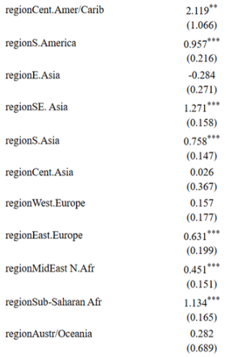



Conclusions - Geography
With N. America as reference level:
E. Asia, W. Europe, Oceania have zero or negative coeffs.

Slide 21



Conclusions - Geography
With N. America as reference level:
SE. Asia, Carribean, Sub-S. Africa have substantially positive (>1.5) coeffs.

Slide 22
Conclusions - Geography
Observation:
Regions w. higher economic development scores have decreased log odds of a successful terrorist attack.
Conclusion:
Countries dedicating budget spending to military and police as well as security and surveillance may hinder the efforts of terrorism.

Slide 23
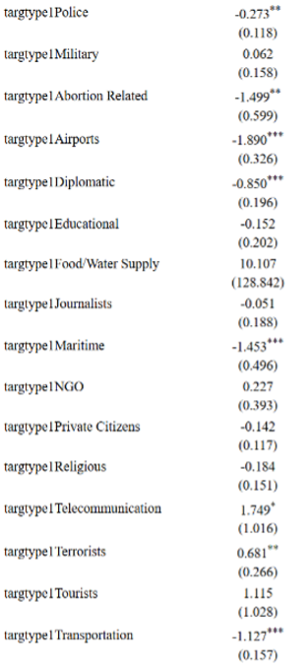









Conclusions - Target
With Business as reference level:
All statistically significant groups are either state-owned targets or militarized in some capacity (excl. Abortion).

Slide 24


Conclusions - Target
With Business as reference level:
All but 1 of the statistically significant groups have negative coefficients.

Slide 25


Conclusions - Target
Observation:
Government/state targets have significantly decreased log odds of a successful attack.
Conclusion:
Government/state facilities (airports, military bases, ports) have significantly stronger security and faster response times than civilian targets, leading to less dangerous (successful) attacks.

Slide 26
Conclusions - Models
Our best model's accuracy of 0.65 is worse than the NIR of 0.855.
In context, the NIR may not be applicable to this problem as a solution.
This dataset has a very high class imbalance.
~6:1
Predicting every incident to be a success (high level threat) may strain resources thin.
Our model may not be perfect, but dismissing it because of NIR ignores the context of the issue at hand.
Performance with Youden's J Threshold (By Class)
Metric | Result
No Information Rate | 0.855
P-Value [Acc > NIR] | 1
Sensitivity | 0.6791
Specificity | 0.6308
PPV | 0.9154
NPV | 0.2506
F1 | 0.7797
Prevalence | 0.8546
Detection Rate | 0.5804
Detection Prevalence | 0.6341
Balanced Accuracy | 0.6550

Slide 27
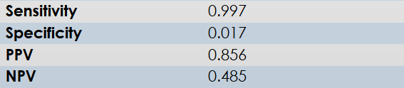
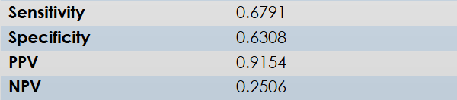
Limitations – J Statistic
Controversy surrounding models using the J-Statistic:
Balances the overall predictive accuracy of the model.
May smooth some metrics at the cost of other performance metrics.
This balance is especially critical in national security applications, where the cost of false negatives (i.e., failing to predict a successful attack) is significantly greater than the cost of false positives.
CV Log Reg
J-Statistic Model

